Slide 1
Information Security
Week 03

Slide 2
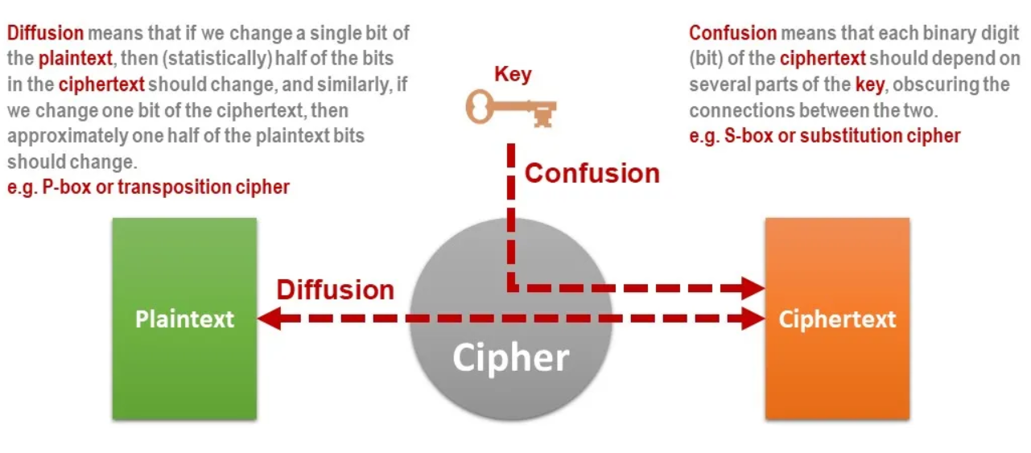
Confusion and Diffusion

Slide 3
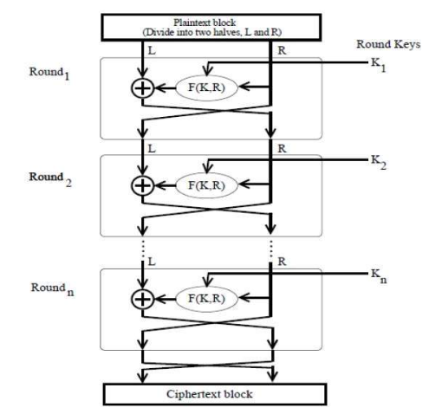
Feistel Function and Network

Slide 4
Block Cipher modes of Operation
A block cipher is a method of encrypting data in blocks to produce ciphertext using a cryptographic key and algorithm.
Block cipher modes of operation define how these blocks are encrypted

Slide 5
Electronic Code Book (ECB)
It is a straightforward way of processing a series of sequentially listed message blocks.
The input plaintext is broken into numerous blocks. The blocks are individually and independently encrypted (cipher text) using the encryption key.
As a result, each encrypted block can also be decrypted individually.

Slide 6
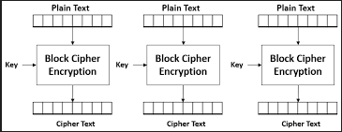

Slide 7
Advantages of using ECB –
Parallel encryption of blocks of bits is possible, thus it is a faster way of encryption.
Simple way of the block cipher.
Disadvantages of using ECB –
Prone to cryptanalysis since there is a direct relationship between plaintext and ciphertext.

Slide 8
Cipher Block Chaining (CBC)
Cipher block chaining or CBC is an advancement made on ECB.
ECB compromises some security requirements.
In CBC, the previous cipher block is given as input to the next encryption algorithm after XOR with the original plaintext block.
In a nutshell here, a cipher block is produced by encrypting an XOR output of the previous cipher block and present plaintext block.

Slide 9
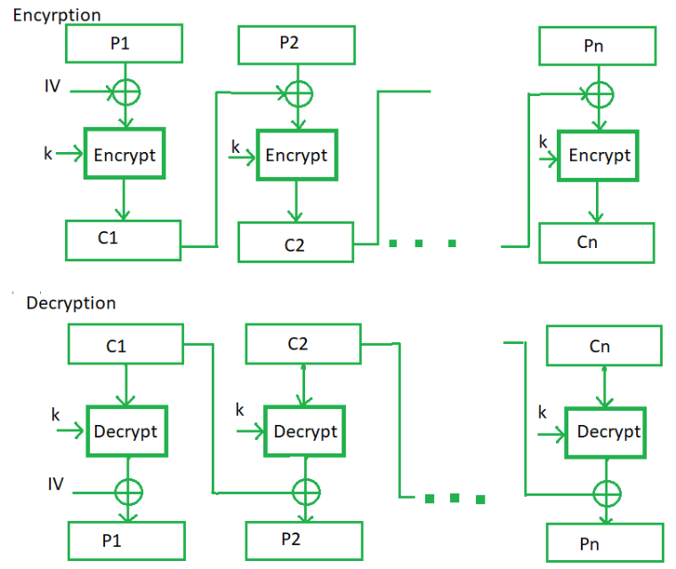

Slide 10
Advantages of CBC –
CBC works well for input greater than b bits.
CBC is a good authentication mechanism.
Better resistive nature towards cryptanalysis than ECB.
Disadvantages of CBC –
Parallel encryption is not possible since every encryption requires a previous cipher.

Slide 11
Cipher Feedback Mode (CFB
In this mode the cipher is given as feedback to the next block of encryption with some new specifications:
First, an initial vector (IV) is used for first encryption and output bits are divided as a set of s and b-s bits.
The left-hand side s bits are selected along with plaintext bits to which an XOR operation is applied.
The result is given as input to a shift register having b-s bits to lhs, s bits to rhs and the process continues.
The encryption and decryption process for the same is shown below, both of them use encryption algorithms.

Slide 12
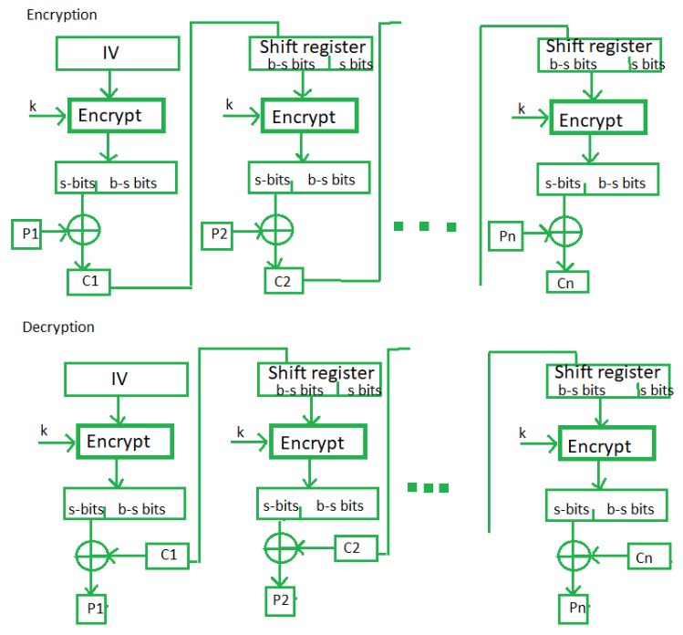

Slide 13
Advantages of CFB –
Since, there is some data loss due to the use of shift register, thus it is difficult for applying cryptanalysis.
Disadvantages of using CFB –
The drawbacks of CFB are the same as those of CBC mode. Both block losses and concurrent encryption of several blocks are not supported by the encryption. Decryption, however, is parallelizable and loss-tolerant.

Slide 14
Output Feedback Mode
The output feedback mode follows nearly the same process as the Cipher Feedback mode except that it sends the encrypted output as feedback instead of the actual cipher which is XOR output.
In this output feedback mode, all bits of the block are sent instead of sending selected s bits.
The Output Feedback mode of block cipher holds great resistance towards bit transmission errors. It also decreases the dependency or relationship of the cipher on the plaintext.

Slide 15
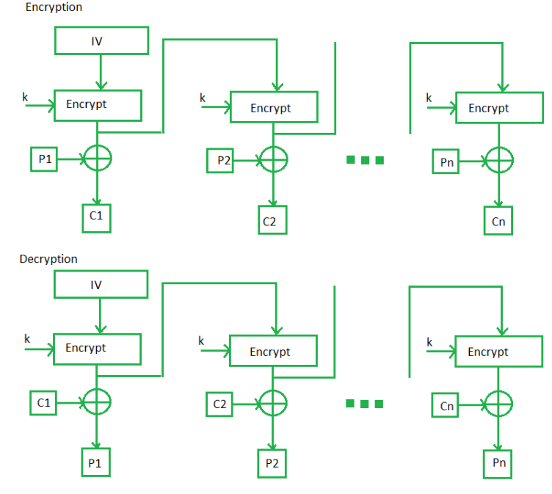

Slide 16
Counter (CTR) mode
CTR mode uses a block chaining mode of encryption as a building block.
The process of encrypting data is performed by XORing the plaintext with a sequence of pseudorandom values.
Each of which is generated from the ciphertext using a feedback function.

Slide 17
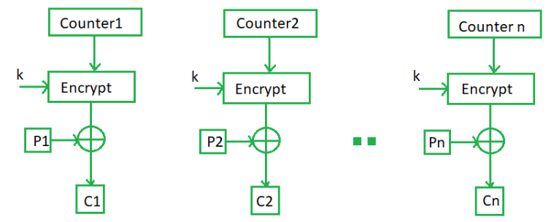

Slide 18
Advanced Encryption Standard (AES)

Slide 19
AES
Advanced Encryption Standard (AES) is a specification for the encryption of electronic data established by the U.S National Institute of Standards and Technology (NIST) in 2001.
AES is widely used today as it is a much stronger than DES and triple DES
Harder to implement.

Slide 20
AES
AES is a block cipher.
The key size can be 128/192/256 bits.
Encrypts data in blocks of 128 bits each.
AES relies on substitution-permutation network principle.
Works on Bytes (Since the block size is 128 bits, the cipher processes 128 bits (or 16 bytes) of the input data at a time).
The number of rounds depends on the key length (128 bit key – 10 rounds, 192 bit key – 12 rounds, 256 bit key – 14 rounds)

Slide 21
Creation of Round keys
A Key Schedule algorithm is used to calculate all the round keys from the key.
Initial key is used to create many different round keys which will be used in the corresponding round of the encryption.

Slide 22
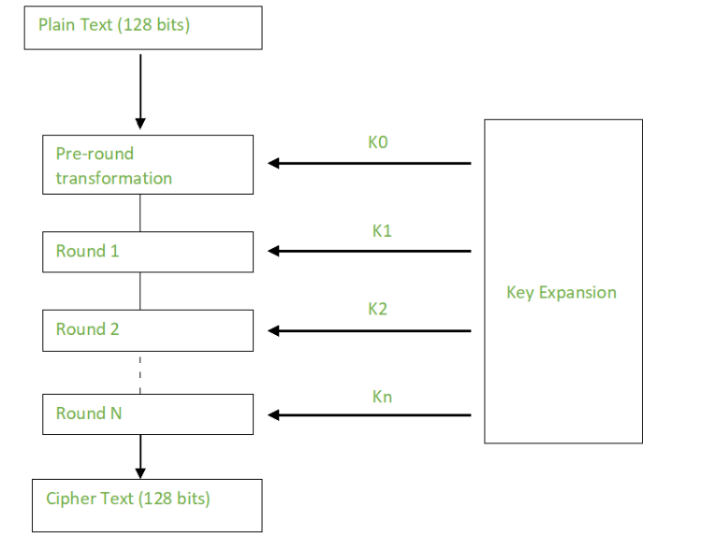

Slide 23
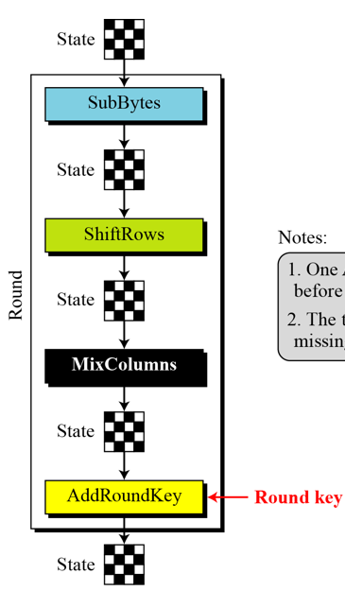

Slide 24
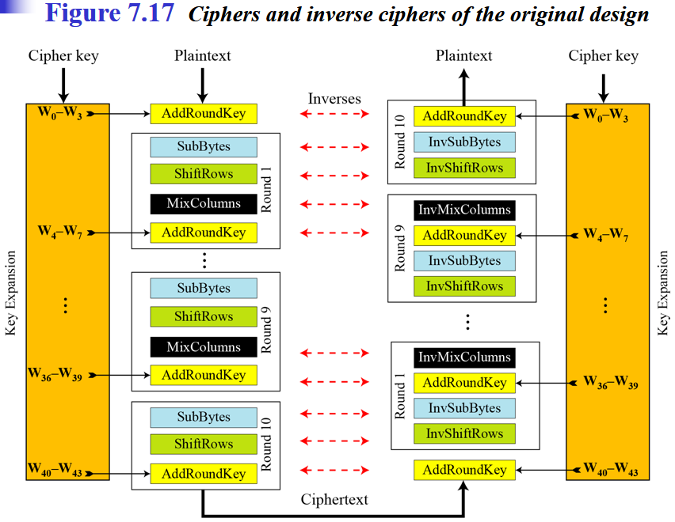

Slide 25
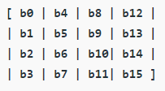
Encryption
ES considers each block as a 16 byte (4 byte x 4 byte = 128 ) grid in a column major arrangement.
Each round comprises of 4 steps :
SubBytes: substitution and ShiftRows
ShiftRows: performs the permutation
MixColumns : performs the permutation
Add Round Key
The last round doesn’t have the MixColumns round.

Slide 26
SubBytes
In this step each byte is substituted by another byte. Its performed using a lookup table also called the S-box.
The result of this step is a 16 byte (4 x 4 ) matrix like before.
2 conditions where substitution never performed:
By it self
Another byte which is a compliment of the current byte

Slide 27
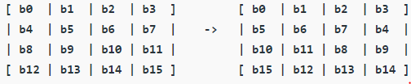
ShiftRows
This step is just as it sounds. Each row is shifted a particular number of times.
The first row is not shifted
The second row is shifted once to the left.
The third row is shifted twice to the left.
The fourth row is shifted thrice to the left.
A left circular shift is performed.

Slide 28
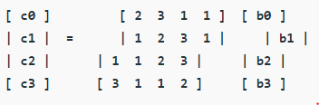
MixColumns
This step is basically a matrix multiplication.
Each column is multiplied with a specific matrix and thus the position of each byte in the column is changed as a result.
This step is skipped in the last round.

Slide 29
Add Round Keys
Now the resultant output of the previous stage is XOR-ed with the corresponding round key.
Here, the 16 bytes is not considered as a grid but just as 128 bits of data.

Slide 30
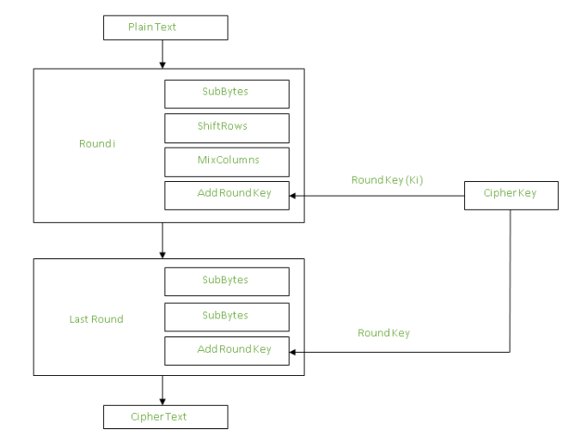

Slide 31
Decryption
The stages of each round in decryption is as follows :
Add round key
Inverse MixColumns
ShiftRows
Inverse SubByte

Slide 32
Applications
Wireless security
Database Encryption
Data storage
Virtual Private Networks (VPNs)
Secure Storage of Passwords
File and Disk Encryption

